Slide 1
Brain MRI Tumor Detection
Google/NACME Applied Machine Learning Intensive Capstone
Julio Sibrian, Alexis Mercado, Gerardo Moreno

Slide 2
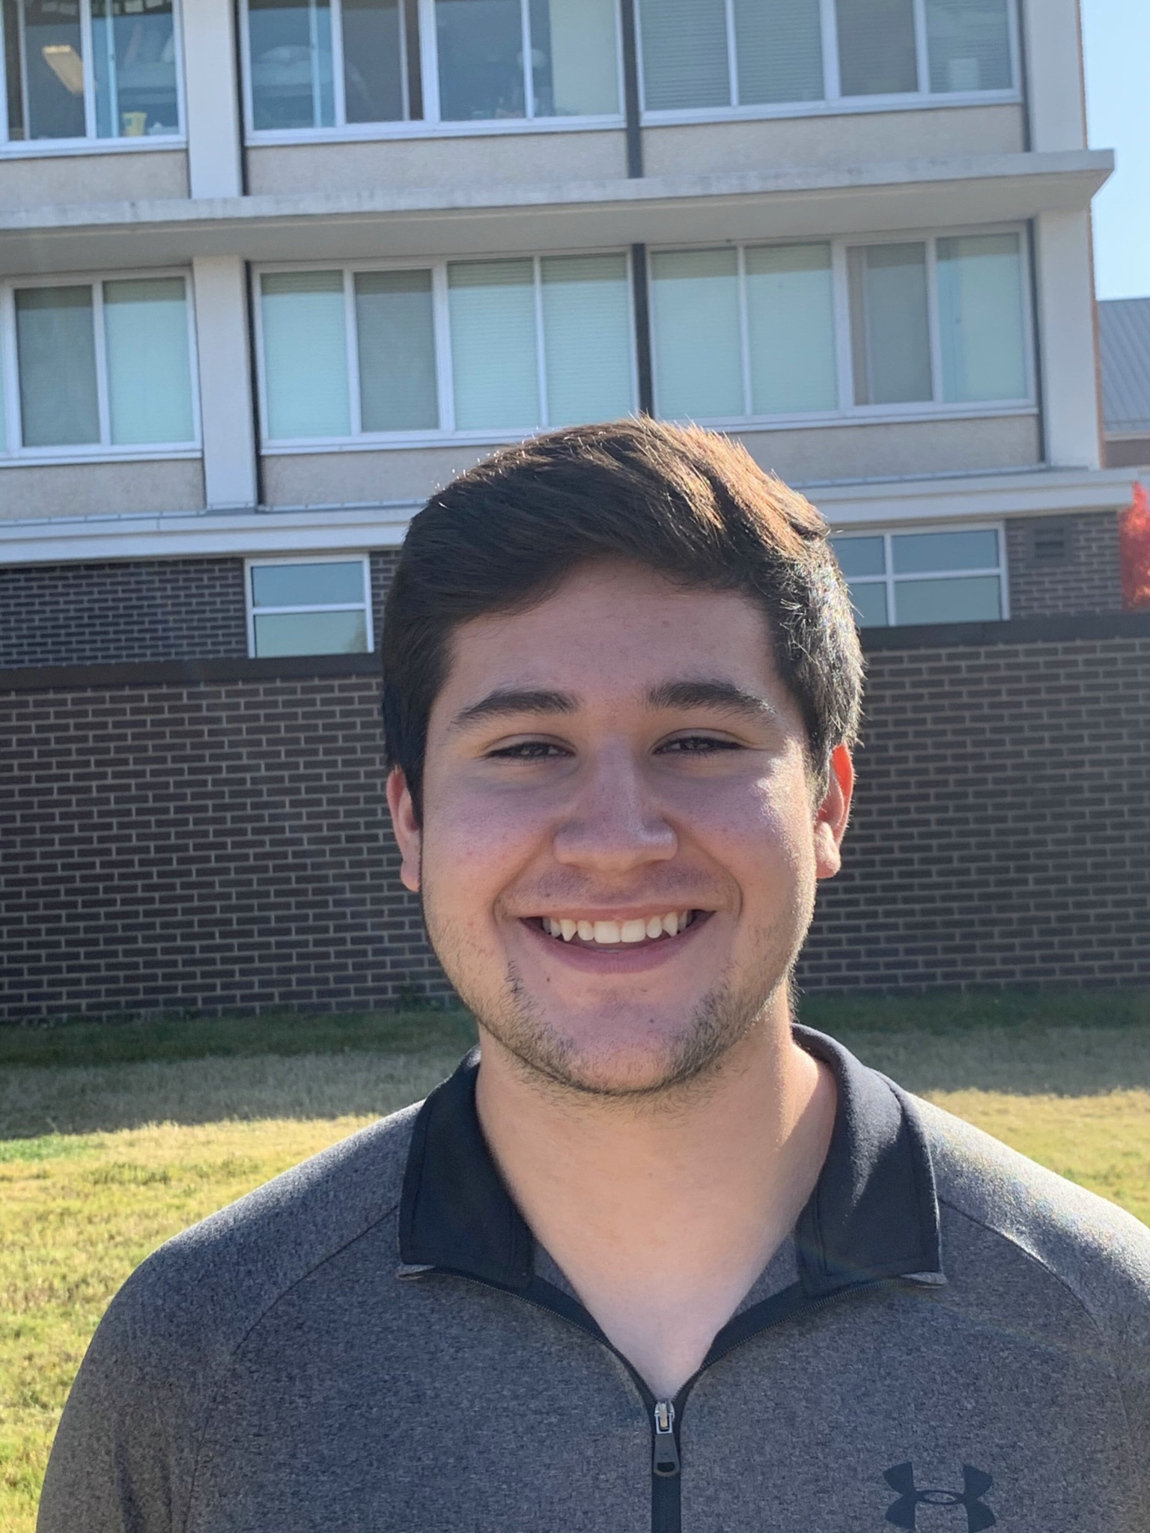
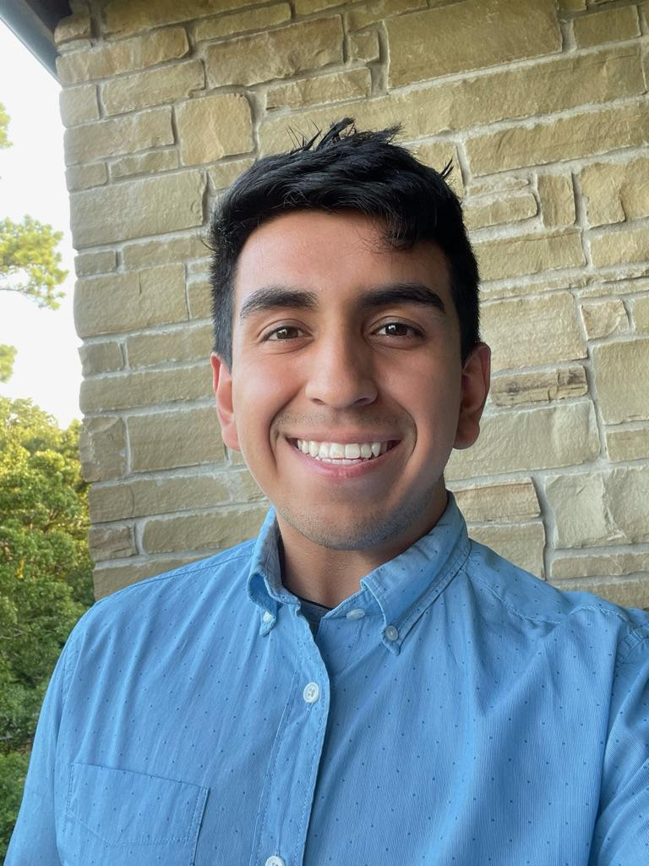
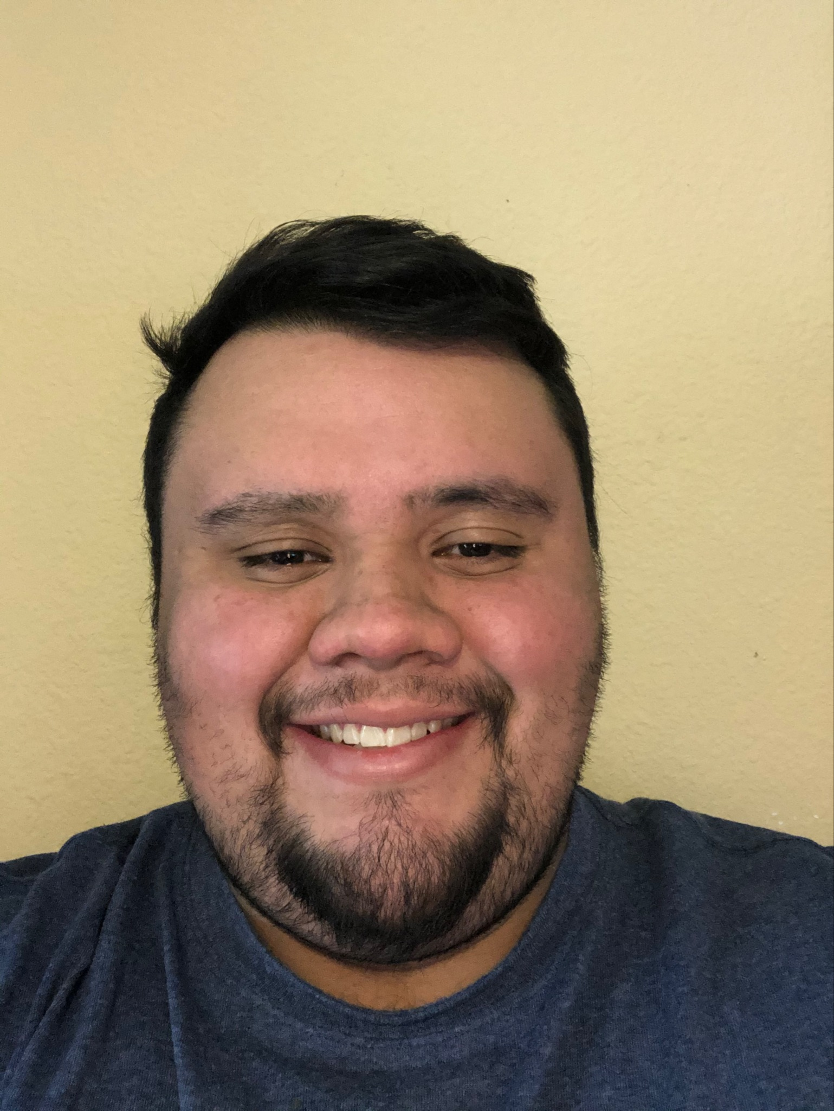
Team Members
Julio Sibrian
University of Arkansas
Computer Science
Gerardo Moreno
University of Arkansas
Data Science
Alexis Mercado
University of Arkansas
Computer Science

Slide 3
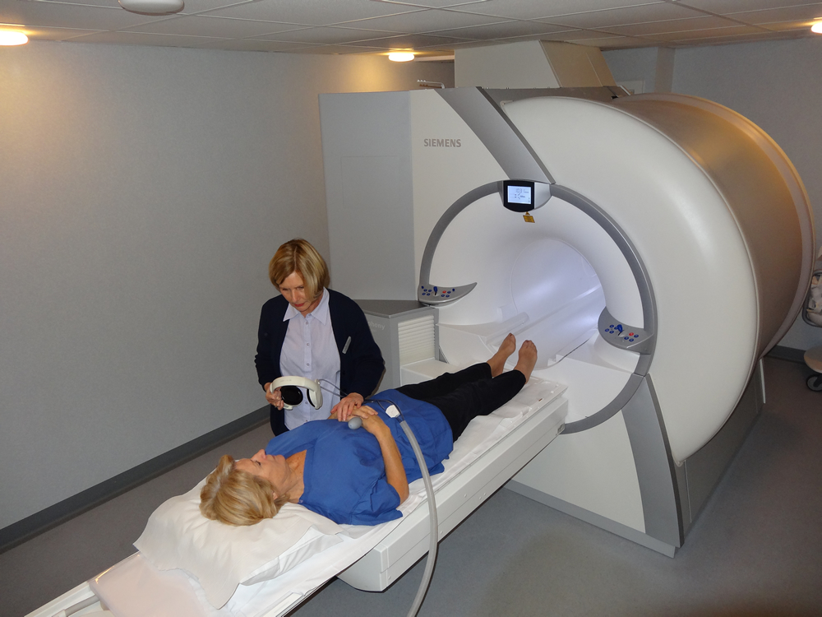
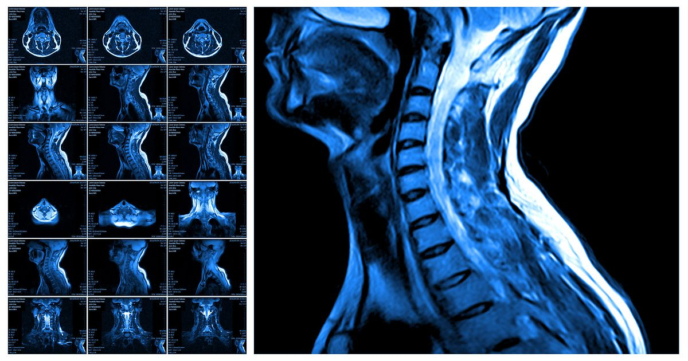
Introduction
There are around 700,000 people currently living with a brain tumor
The survival rate for them is about 75%.
Source: National Brain Tumor Society
Notes:
Sometimes these tumors may be difficult to detect because of the fact that symptoms may not be shown. Tumors are a time sensitive issue and every minute counts when detecting a tumor and providing adequate treatment.

Slide 4
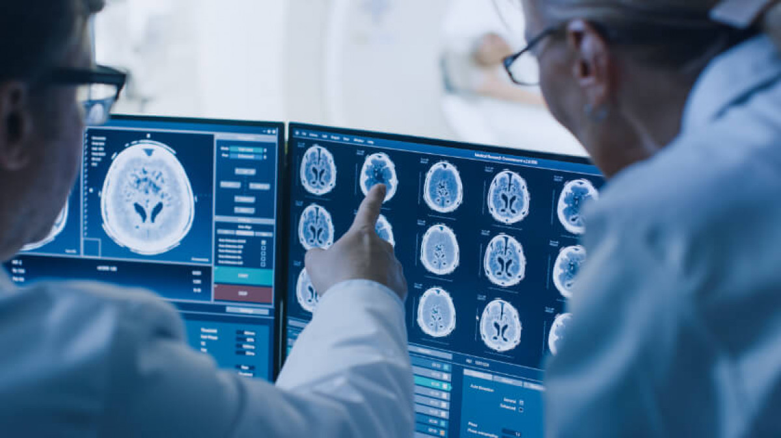
Project Motivation
The goal of this project is to address the issues of tumors and be able to diagnose them through machine learning. The benefits of this project would be the automation of a process that is typically done in person by a professional. We aim to create a program that could potentially speed up the process and even free up the professionals time in order for them to tend to more patients.

Slide 5

Overview
MRI Scans
Convolutional Neural Networks (CNN)
TensorFlow
Keras Library
Model Analysis

Slide 6
Capstone Timeline
Data Visualization
Exploratory Data Analysis
Building CNN Model
Utilizing TensorFlow and Keras
Data Augmentation
Balance Data and Image Enhancements
Model Analysis
Analysis of Final Model

Slide 7
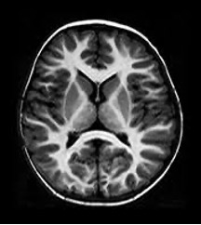
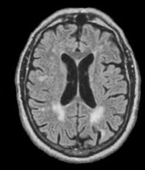
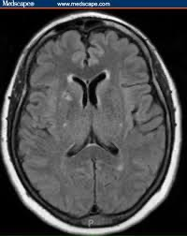
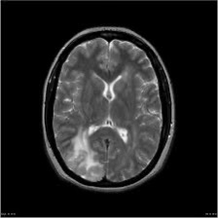
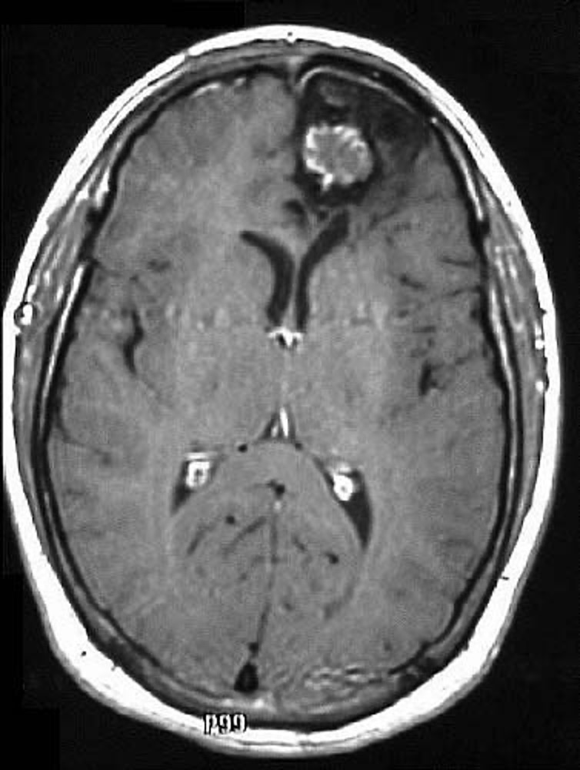
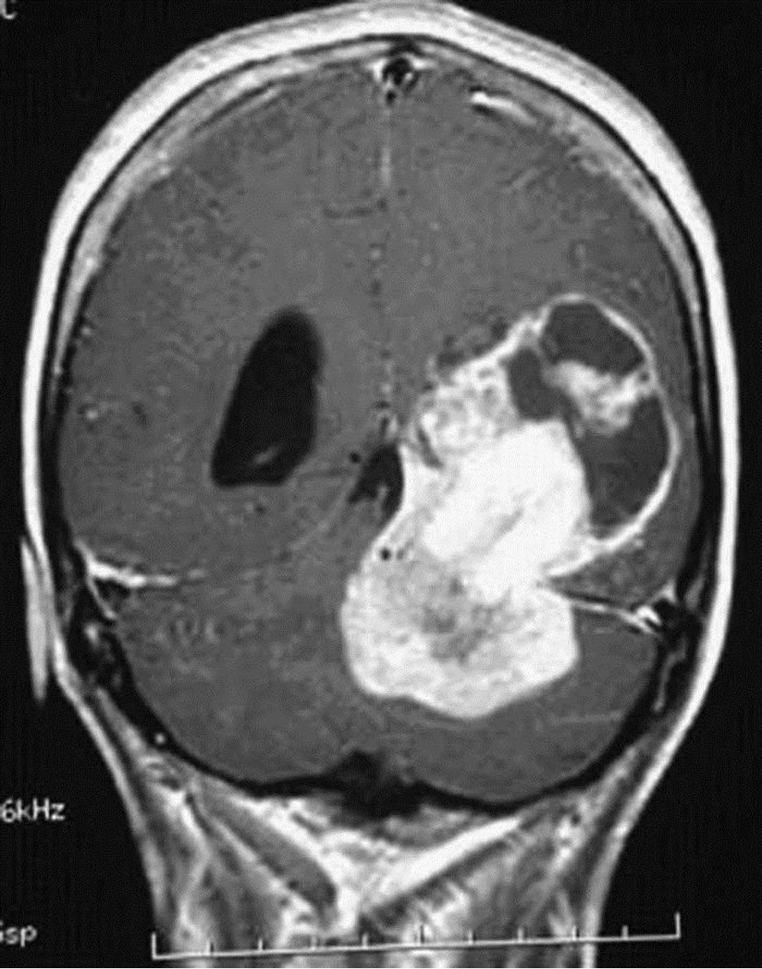
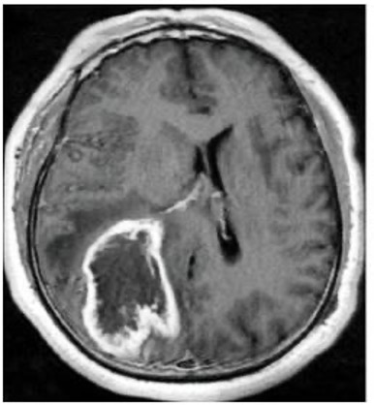
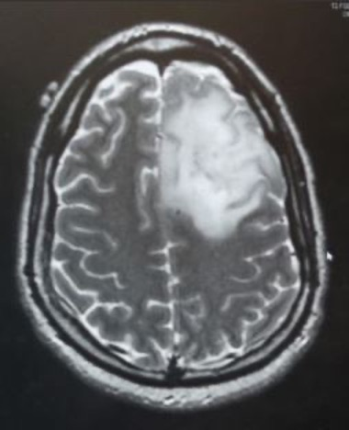
Data Visualization
Tumor MRI’s: 155
Normal MRI’s: 98
MRI’s with
no tumors
MRI’s
with tumors
Dataset: https://www.kaggle.com/navoneel/brain-mri-images-for-brain-tumor-detection

Slide 8
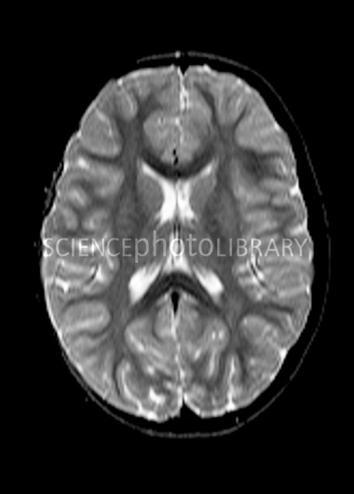
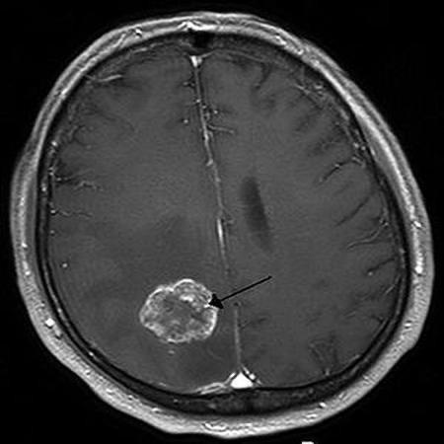
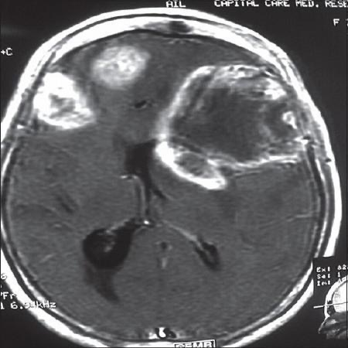
Bad Data

Slide 9
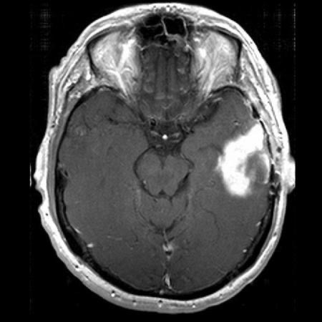
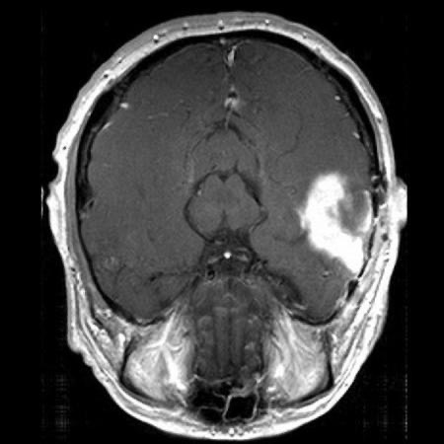
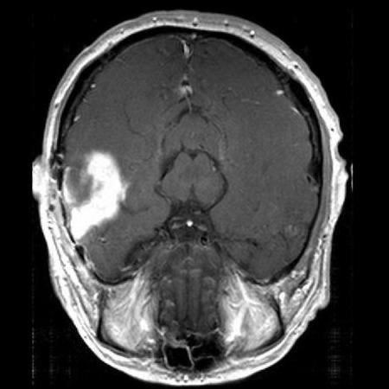
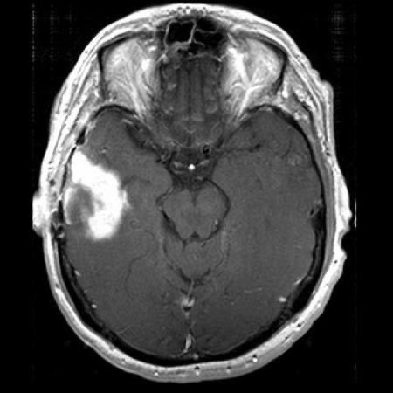
Data Augmentation
Regular
Flipped
Rotate 180
Mirrored

Slide 10
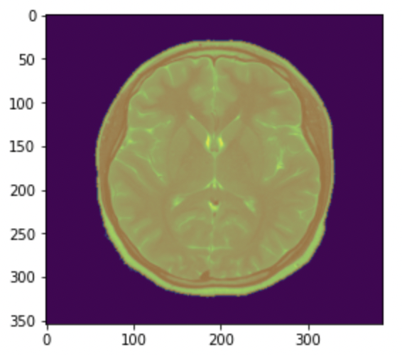
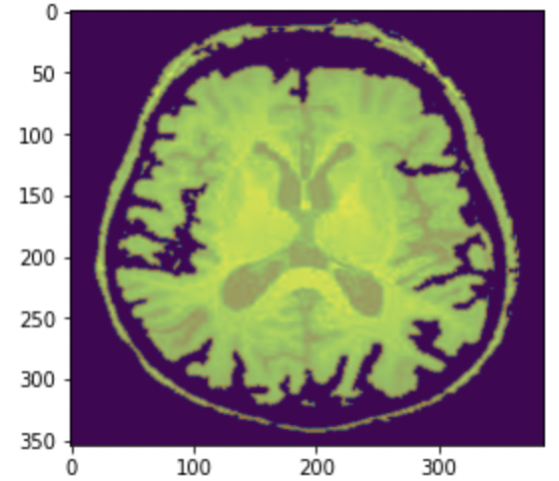
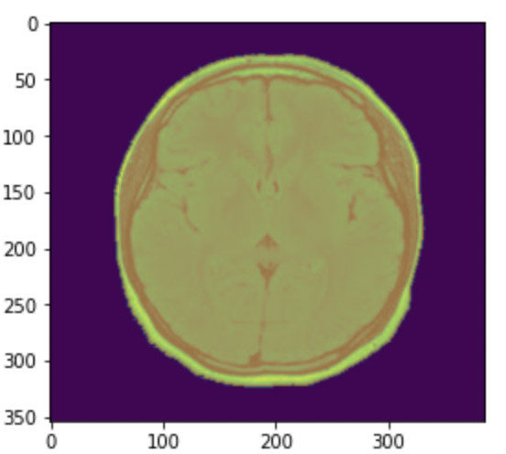
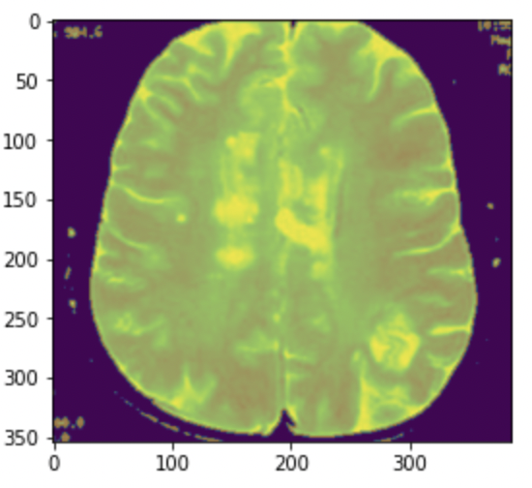
Masking

Slide 11
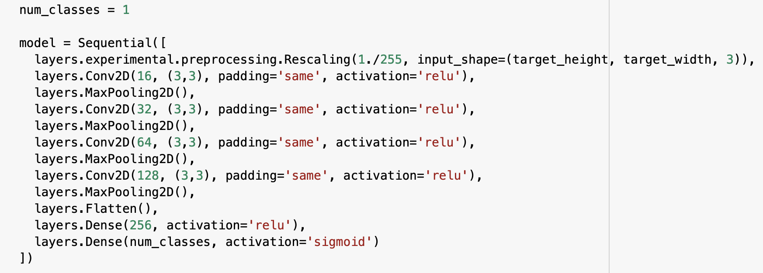
Building our Model
School Name
Anytown, ST
MBA: May 20XX
School Name
Anytown, ST
BS, Computer Science: May 20XX
School Name
Anytown, ST
AdTech Lab: January 20XX

Slide 12
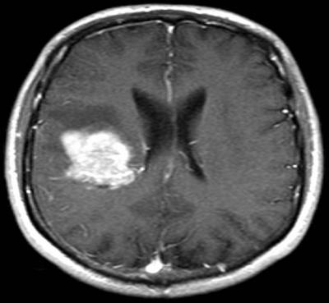
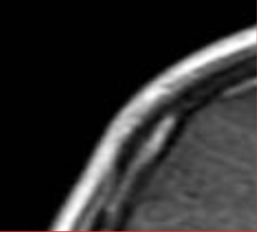
Kernel and Strides

Slide 13
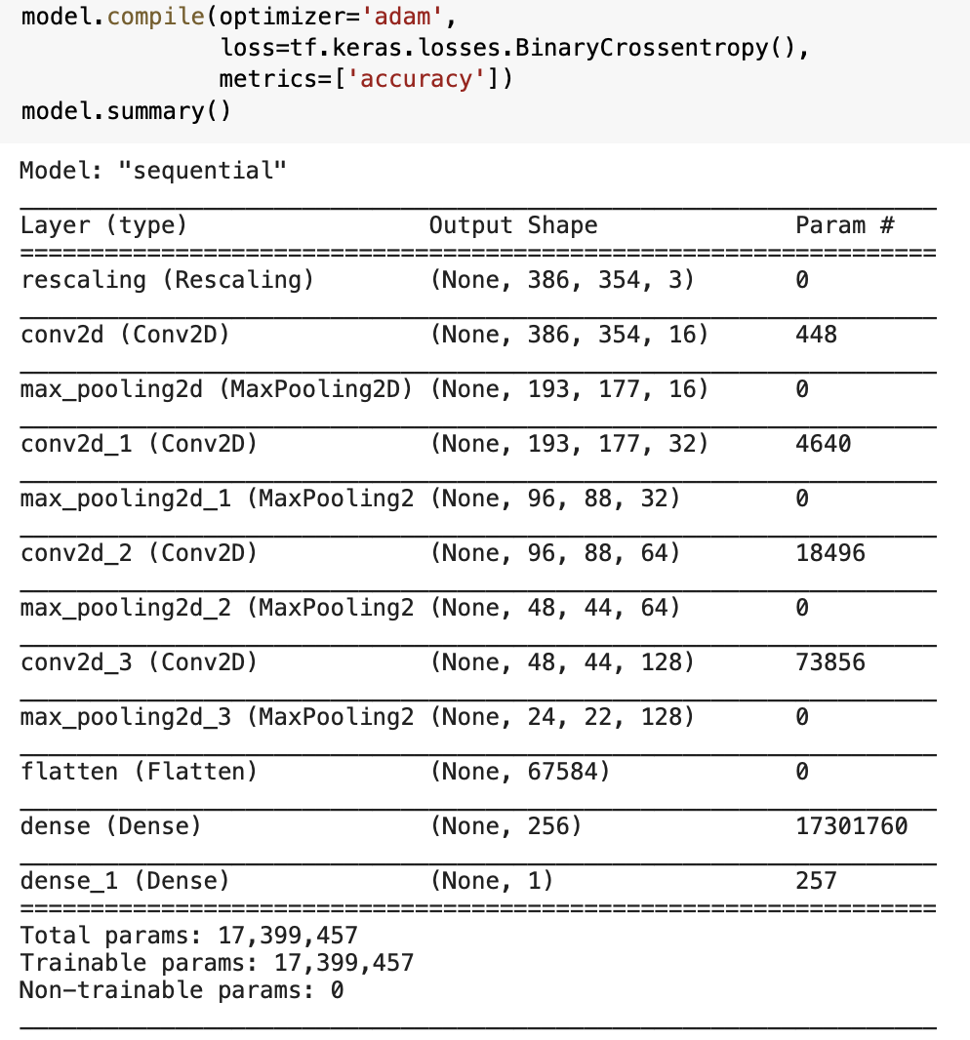
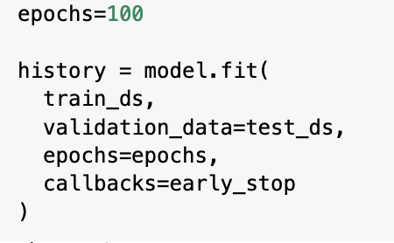
Compiling the Model

Slide 14
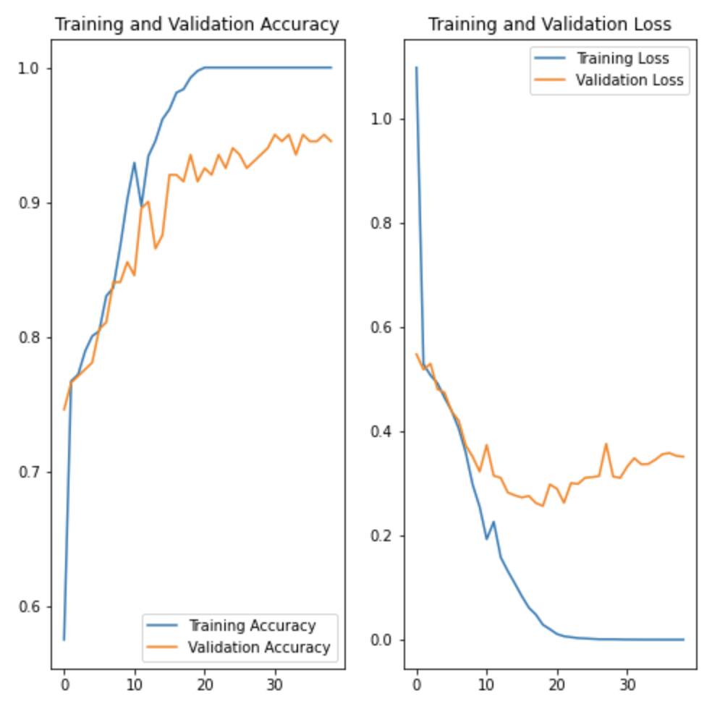
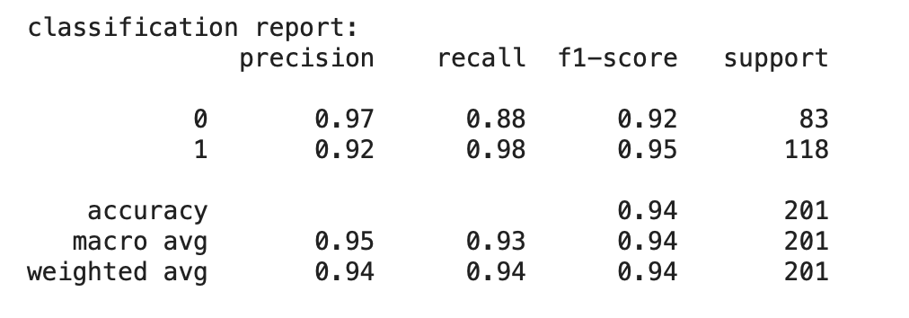
Analyzing Model
School Name
Anytown, ST
MBA: May 20XX
School Name
Anytown, ST
BS, Computer Science: May 20XX
School Name
Anytown, ST
AdTech Lab: January 20XX

Slide 15

Trial and Errors
Further Data Augmentation (rotation: 90, 270)
Loss Functions (hinge loss, and squared hinge loss)
Optimizers(Adagrad, Adadelta, RMSprop)
Kernel sizes ( (1x1), (2x2), (3x3), (4x4) )
Activation methods (Hidden: sigmoid, elu, tanh; Output: softmax, linear)

Slide 16

Predictions

Slide 17
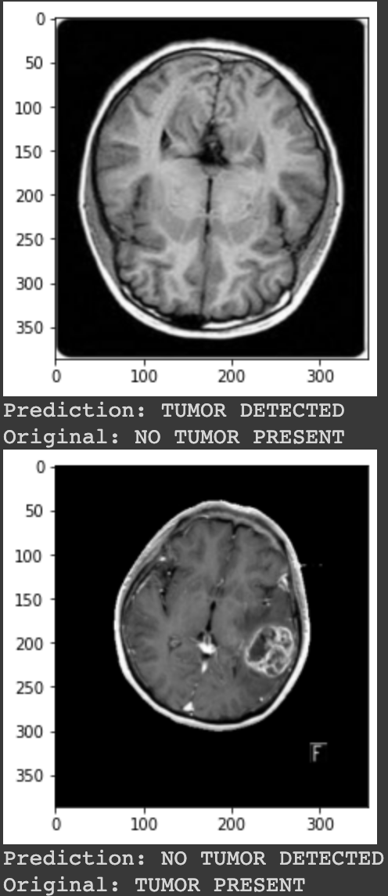
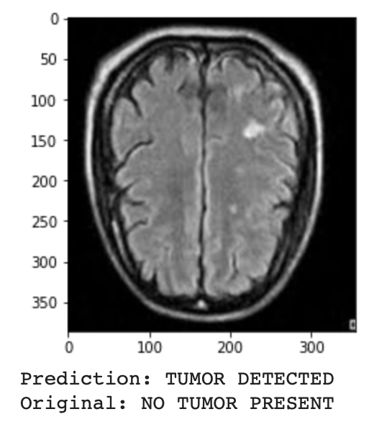
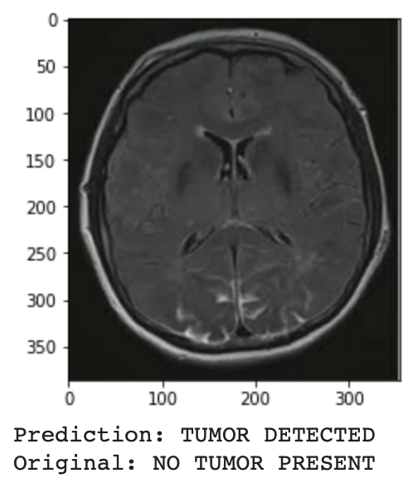
Samples of Misclassification

Slide 18

Conclusion
Problems encountered
Images
CNN’s
Final Model
Improvements
Future

